Slide 1
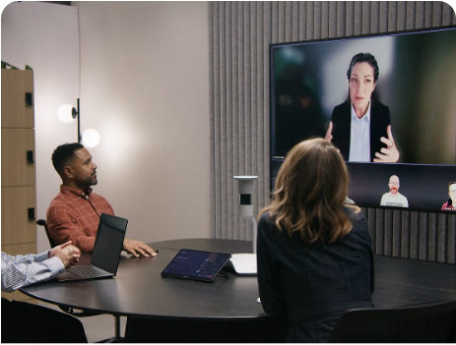
CAPSTONE PROJECT DEMO
Meeting Intelligence & Action Tracking System
HIT RECORD.
WE HANDLE THE REST.
1
Transcript
2
Meeting intelligence
Jira · Calendar
Gmail · Slack
3
PROJECT TEAM - Cohort-6 Batch-4
Mohan Reddy (Coordinator) 2616382
Chethan L 2616808
Pullaiahgari Manideep Reddy 2616388
Swetha Raut 2616306
Chaitali Prabhu 2616376
Seema Sada Shanker 2616385
Sharmila Pallipati 2617489
Mentor: Aarnav Singh

Slide 2



The gap between meeting summaries and tracked work
PROBLEM STATEMENT · AFTER THE MEETING
PLATFORM CAPABILITIES
Meeting intelligence
CURRENT OUTPUT
A static document
WORK LEFT TO PEOPLE
Manual follow-through
ZOOM, TEAMS AND GOOGLE MEET
Transcription captures the discussion
AI summaries recap the meeting
Action-item extraction suggests tentative owners
WHERE THE WORKFLOW STOPS
The recap records what was discussed
Extracted actions remain in the document
Participants must turn those actions into tracked work
WHAT PARTICIPANTS STILL DO
Create tasks and schedule follow-ups
Archive meeting records
Track progress and verify completion
OUTPUT
Transcript and action items
GAP
Summary without execution
RISK
Meeting outcomes get lost
The last mile: turning extracted action items into tracked work and completed commitments

Slide 3
Action items become tracked work
PROJECT APPROACH · DOWNSTREAM INTEGRATIONS
JIRA
Task creation
GOOGLE CALENDAR
Follow-up scheduling
GOOGLE DOCS AND EMAIL
Documentation
WHAT THE SYSTEM DOES
Turns extracted action items into Jira tickets
Includes an owner and deadline
Links each ticket to the meeting
WHAT THE SYSTEM DOES
Identifies follow-ups from the meeting
Creates Google Calendar events
Includes the relevant participants
WHAT THE SYSTEM DOES
Creates meeting notes in Google Docs
Preserves a shared meeting record
Emails a summary to participants
OUTCOME
Actions become tracked tickets
OUTCOME
Follow-ups enter calendars
OUTCOME
Notes stored and shared
Extracted action items are the starting point. The system continues beyond the meeting summary.

Slide 4
One upload in, tickets, invites and emails out
PROPOSED SOLUTION · ARCHITECTURE AND WORKFLOW
1 Meeting processing
2 Meeting intelligence
3 Action tracking
TEXT PATH
JSON transcript
Parsed to plain text
1 Jira agent
Create or update
AI EXTRACTION
GPT-5 extraction
Summary, decisions, action items, risks, follow-up as JSON
INPUT
Intake form
Title, emails, file
ORCHESTRATOR
Super Agent
gpt-5-mini
2 Calendar
Reminders, follow-up
AUDIO PATH
Audio file
AssemblyAI with speaker labels
3 Gmail & Docs
Notes and email
Slack digest
Weekly, from Jira

Slide 5
Under the hood: from raw audio to action in three smart stages
ARCHITECTURE EXPLAINED · HOW THE THREE STAGES WORK
STAGE 1
Meeting processing
STAGE 2
Meeting intelligence
STAGE 3
Action tracking
OUTPUT
Diarized transcript
JSON input parsed to plain text
Audio sent to AssemblyAI with speaker labels
Lines formatted as “Speaker Labels: …”
BUILT WITH
n8n intake form · AssemblyAI
OUTPUT
Structured JSON
GPT-5 extracts summary, topics, decisions, action items, risks and follow-up
Writes “Unassigned” or “No deadline” gets assigned to host
Assembly step writes Jira text and the HTML MOM email
BUILT WITH
GPT-5 extraction prompt
OUTPUT
Tickets, events, MOM email
Jira agent: creates or updates tickets, never duplicates
Calendar agent: schedules reminders and follow-up meetings
Gmail & Docs agent: notes doc, MOM auto-emailed to all
BUILT WITH
gpt-5-mini–Super Agent · Slack
Extracted actions become Jira tickets and Calendar events, with meeting notes saved and emailed.

Slide 6
Two release meetings in, a ready Jira board out
USE CASE · RELEASE-READINESS MEETINGS
INPUT · TRANSCRIPT 1
Deadlines agreed
INPUT · TRANSCRIPT 2
Progress reviewed
OUTPUT · AUTOMATED
Work tracked
MEETING 1 · KICKOFF
6 dated tasks, due by 2 Oct
Chethan · Requirements doc, 28 Sep
Chethan · API access, 29 Sep
Mohan · PM integration, 30 Sep
Mohan · Build handover, 1 Oct
Sharmila · Testing + report, 2 Oct
Seema · Final review, 2 Oct
DECISION
Assignee dashboard moved to next release
MEETING 2 · FOLLOW-UP
4 tasks closed, 2 added
Done · Requirements doc
Done · API access
Done · PM integration and build
In progress · Testing, 1 defect in retest
New · Mohan fixes last defect today
New · Sharmila confirms final QA
OPEN ITEM
1 defect, then release decision
SYSTEM ACTIONS
Tracked without retyping
Jira · 6 tickets created, then updated
Calendar · Reminder per deadline
Calendar · Follow-up booked with all
Docs + Gmail · Notes, recap email
Slack · Weekly overdue digest
RESULT
One live view of release status
Kickoff sets 6 dated tasks → Follow-up closes 4 and adds 2 → Only 1 defect stays open before release

Slide 7
The meeting ends, the MOM is already in your inbox
USE CASE · AUTOMATIC MOM / MEETING SUMMARY EMAIL
AUTO MOM EMAIL · TEST 1
Kickoff meeting
AUTO MOM EMAIL · TEST 3
Follow-up meeting
IN EVERY EMAIL
Tracking links
SUMMARY
Release set for Fri, 2 Oct
7 actions · all High priority
Chetan · Requirements, API by 29 Sep
Mohan · Integration, build by 1 Oct
Mani Deep · Testing and report, 2 Oct
Seema · Final review, 2 Oct
DECISIONS
Overdue dashboard in; Azaini deferred
SUMMARY
Dev complete, final QA pending
Closed · Requirements and API access
Mohan · Last defect fix, due today
Manidip · Retest, confirm QA status
Chetan · Update docs, Medium
Risk · Retest may find critical issues
NEXT
Go/no-go meeting after retest
TRACKING
Jira and Calendar references
Jira · TASK-101, 102, 103
Calendar · Milestone, 9 Oct 10:00
Topics · Scope, owners, timeline
Risks · Each flagged with its impact
Follow-up · Next meeting proposed
SENT TO
All participant emails from the form
Recording uploaded → n8n workflow runs → MOM emailed automatically, no manual step → Jira and Calendar updated

Slide 8
FROM UPLOAD TO JIRA IN ONE RUN
See it run live
cnprabhu5.app.n8n.cloud/form/meeting-intake
n8n Meeting Intake Form, deployed on n8n Cloud
01
02
03
04
05
06
Upload recording and participant emails
AssemblyAI diarized transcript
GPT-5 extraction
Super Agent delegates
Jira tickets created or updated
Docs, email, Calendar and Slack

Slide 9
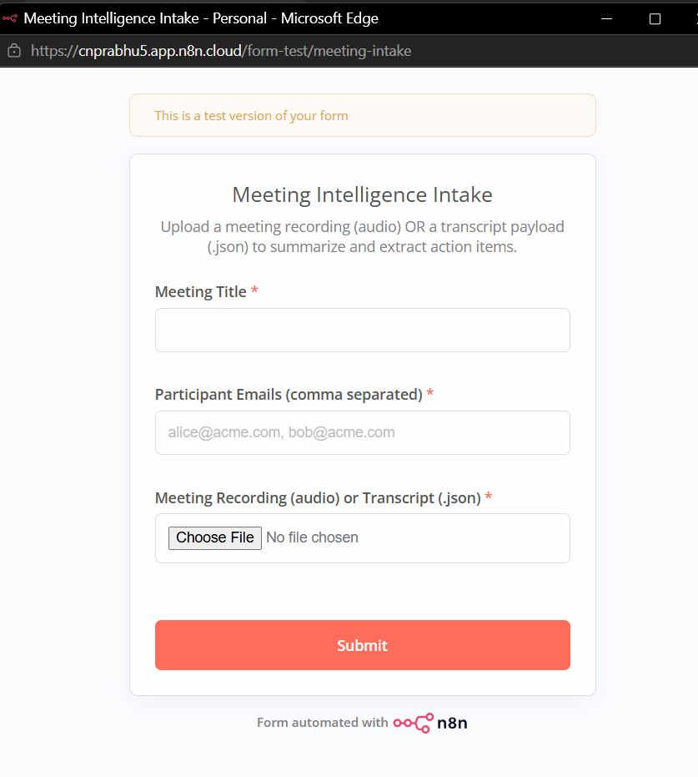
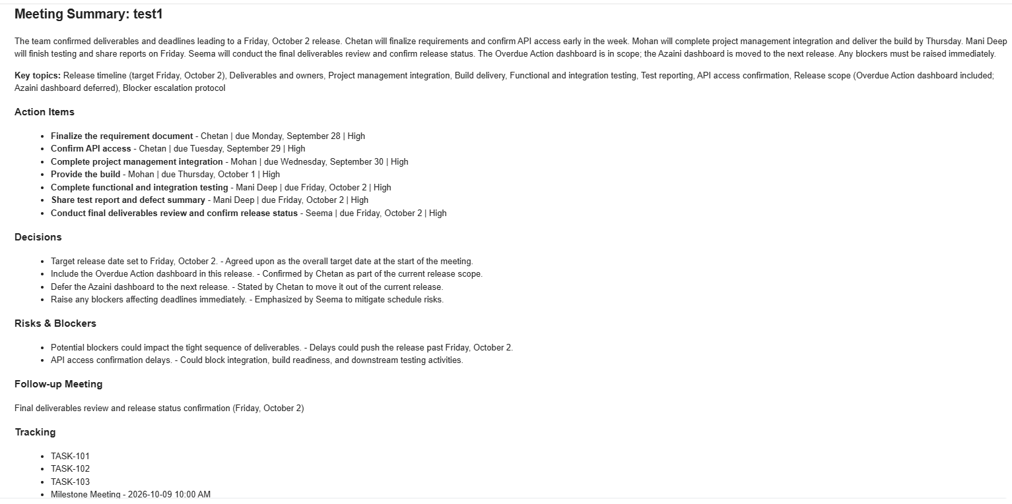
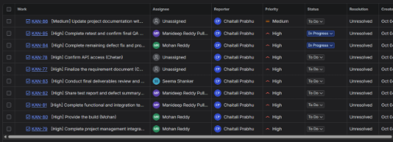
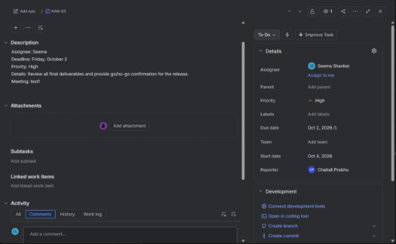
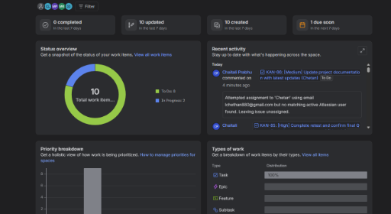
One upload, three proofs: the form, the inbox and Jira
USE CASE · INTAKE FORM, MOM EMAIL AND JIRA RESULTS
Intake form
MOM email
Jira dashboard
Jira dashboard with story
Jira Dashboard with graphical representation & status tracking
Live: cnprabhu5.app.n8n.cloud/form/meeting-intake

Slide 10
Implementation challenges and design choices
IMPLEMENTATION · CHALLENGES AND RESPONSES
IMPLEMENTATION CHALLENGE
DESIGN RESPONSE
Missing owners and deadlines in the discussion
Extraction marks missing details as “Unassigned” or “No deadline”
Duplicate Jira tickets across follow-up meetings
Jira agent searches by title, then updates existing tickets
Waiting for audio transcription results
Poll AssemblyAI every 15 seconds for completion
Scattered meeting records
Create Google Docs notes and email the summary
Including ticket and event links in the summary
Run Jira and Calendar before sending the summary email
Design choices: Jira holds the tracked tasks. The workflow runs Jira and Calendar before the email step so the summary can include the created tickets and events.

Slide 11
What’s next: smarter, sharper, self-checking
FUTURE SCOPE
CAPTURE
Zoom, Teams, Meet capture
Pull recordings in automatically instead of uploading by hand
CAPTURE
Multilingual support
Transcription and extraction for meetings held in other languages
ACCURACY
Speaker names, not labels
Map “Speaker A” labels to participant names
ACCURACY
Stricter assignee matching
Match Jira users by email; ask for confirmation when a match is ambiguous
ACCURACY
Actual meeting date
Default the start date to the meeting date, not the form submission date
QUALITY
Judge as a quality gate
Run the Claude judge inside the workflow before any downstream action

Slide 12
Business value and proposed measures
BUSINESS PERSPECTIVE · IMPACT
WORK LEFT TO PARTICIPANTS
PROPOSED MEASURES · NOT REPORTED RESULTS
Manual task entry
Turn extracted actions into tasks with owners and deadlines
Task creation speed
Measure: time from meeting upload to Jira ticket creation
Task completeness
Measure: share of tickets with an owner, deadline and meeting reference
Manual scheduling
Arrange follow-up meetings with the relevant participants
Follow-up scheduling
Measure: share of identified follow-ups with Calendar events
Scattered meeting records
Store notes and share the summary with participants
Documentation coverage
Measure: share of meetings with a Google Doc and emailed summary

Slide 13
Action items become tracked work
The workflow carries extracted actions into Jira and Calendar, then saves and shares the meeting notes.
Q&A
Try the form
cnprabhu5.app.n8n.cloud
/form/meeting-intake
GITHUB Link (Repository store)
https://github.com/lchethan880/Cohort6-Group4-Meeting-Intelligence-Action-Tracking
Meeting notes Google Docs stores a record of the discussion
Tracked tasks Jira tickets include owners, deadlines and meeting references
Scheduled follow-ups Calendar events include relevant participants
Shared summaries Participants receive the meeting recap by email

